Slide 1
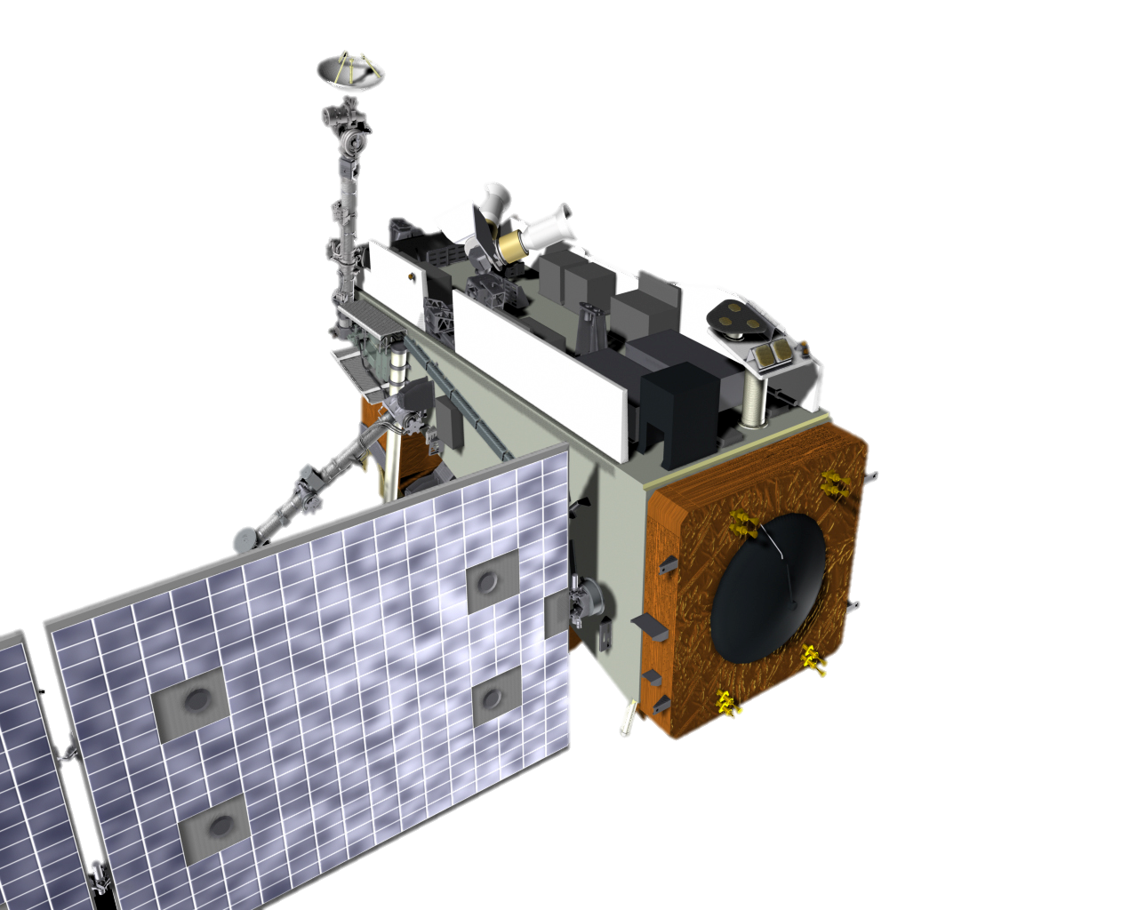
NOAA Level-2 Geophysical Products from VIIRS, CrIS and ATMS Overview and Status of Releases via CSPP
Mitch Goldberg
Co-Authors: Bonnie Reed and Arron Layns
Notes:
I think your main message should be "have confidence in our HRD data as much as SMD data"
2nd messgae is here's all the newproducts you can get!

Slide 2
JPSS Level-2 Geophysical Products - Intro
The Joint Polar Satellite System (JPSS) Suomi National Polar-orbiting Partnership (S-NPP) and NOAA-20 satellites provide global coverage of level-2 geophysical products from the Visible Infrared Imager Radiometer Suite, (VIIRS), Cross-track Infrared Sounder (CrIS), Advanced Technology Microwave Sounder (ATMS), and the Ozone Mapping Profiler Suite (OMPS) instruments.
These imagery, cloud, aerosol, land, ocean and atmospheric products are available to users via the NOAA Product Distribution and Access (PDA) and the Comprehensive Large Array-data Stewardship System (CLASS).
The JPSS program has been working with the Cooperative Institute for Meteorological Satellite Studies (CIMSS) at the University of Wisconsin (UW) to migrate the same high quality JPSS algorithms to the Community Satellite Processing Package (CSPP) which supports the Direct Broadcast (DB) meteorological and environmental satellite community.

Slide 3
CSPP and JPSS
Community Satellite Processing Package (CSPP) is a collection of free and open source software packages for processing direct broadcast (DB) data from polar-orbiting and geostationary meteorological satellites.
University of Wisconsin, Cooperative Institute for Meteorological Satellite Studies (CIMSS) provides the CSPP to regional and global DB users.
NOAA/NESDIS/Satellite Applications and Research (STAR) develops, tests, and provides JPSS Enterprise Algorithms to CIMSS where they get integrated into and distributed via CSPP.

Slide 4
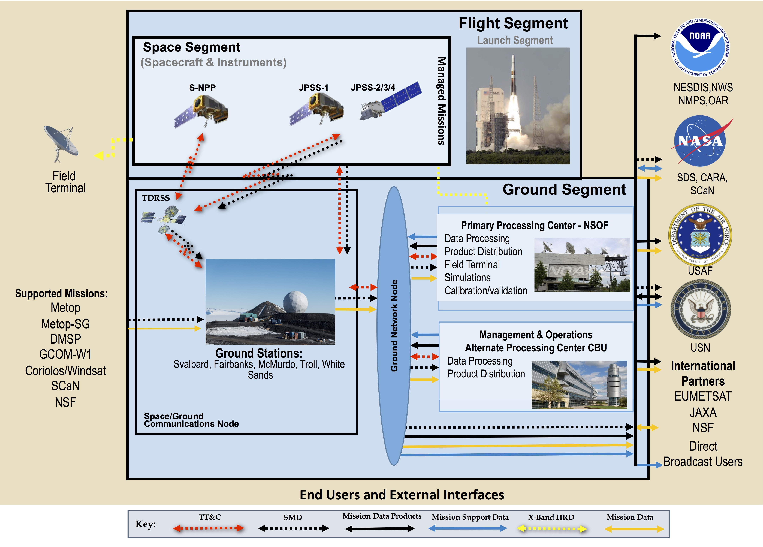
JPSS Series Mission Architecture
JPSS Enterprise Algorithms run within the JPSS Ground System and generate environmental data products from Stored Mission Data (SMD) using high quality science and rigor.
The same JPSS Enterprise Algorithms run within CSPP and generate the same high quality data products from the High Rate Data (HRD) stream.

Slide 5
CSPP Provides NOAA Enterprise Algorithms
Enterprise Algorithm
A term used to describe an algorithm that uses the same scientific methodology and software base to create the same classification of product from differing input data (satellite, in-situ or ancillary).
Benefit of migrating NOAA Enterprise Algorithms to CSPP
Allows for consistency between the algorithms used to process the global data at NESDIS and algorithms used for DB.
Provides for well-documented and well-validated algorithms.
Supports real-time applications using the most up-to-date science.
Improves coordination between the JPSS science teams (STAR), CIMSS, CSPP, and satellite data users.
Facilitates data product improvement based on feedback from the DB users to the science teams.
Applies to data from multiple instruments on both polar-orbiting and geostationary satellites.
Ensures continuity of NOAA satellite-derived products between current and future satellites.

Slide 6
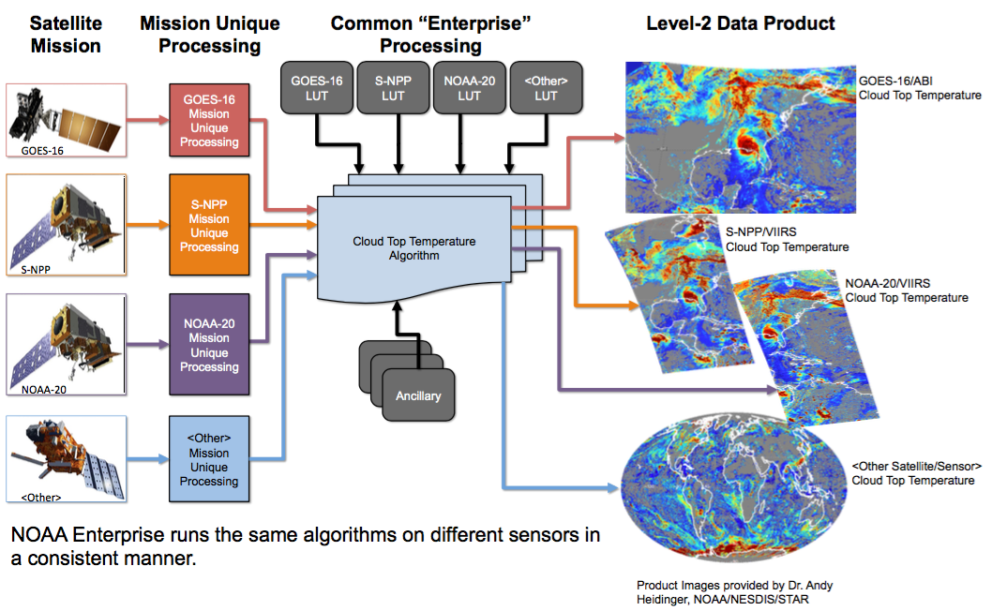
NOAA Enterprise Algorithm Example

Slide 7
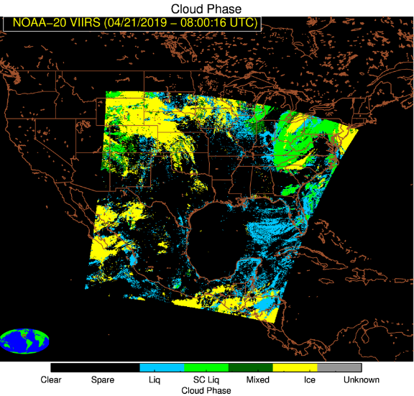
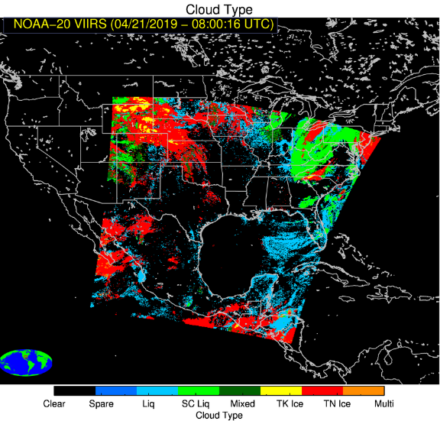
JPSS Data Products available via CSPP VIIRS Cloud Products
Cloud Mask | Describes the area of the Earth’s horizontal surface that is masked by the vertical projection of detectable clouds.
Cloud Top Height | Set of heights above mean sea level of the tops of the cloud layers for each cloud-covered Earth location.
Cloud Base Height | Height above sea level where clouds occur.
Cloud Cover Layers | Fraction of a given area of the Earth’s horizontal surface that is masked y the vertical projection of clouds.
Cloud Optical Depth | Optical depth of the atmosphere due to cloud droplets, per unit cross section integrated over every distinguishable cloud layer and all distinguishable cloud layers in aggregate, in a vertical column above a horizontal cell on the Earth’s surface.
Cloud Particle Size Distribution | Representation of the cloud particle size distribution. The effective radius is defined as the ratio of the third moment of the drop size distribution to the second moment, averaged over a layer of air within a cloud.
Cloud Phase and Type | Provides the primary phase of the cloud (Clear, Liquid, supercooled, Mixed, Ice, and Unknown).
Cloud Top Pressure | Atmospheric pressures at the tops of the cloud layers overlying each cloud-covered Earth location.
Cloud Top Temperature | Atmospheric temperature at the tops of the cloud layers overlying each cloud-covered Earth location.
Above (from left to right)
Cloud Top Temperature, Cloud Height, and Cloud Top Pressure
Below (from left to right)
Cloud Phase and Cloud Type

Slide 8
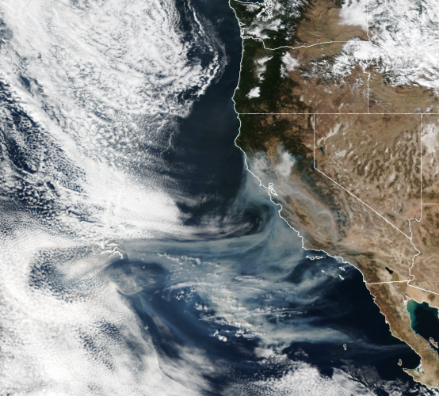
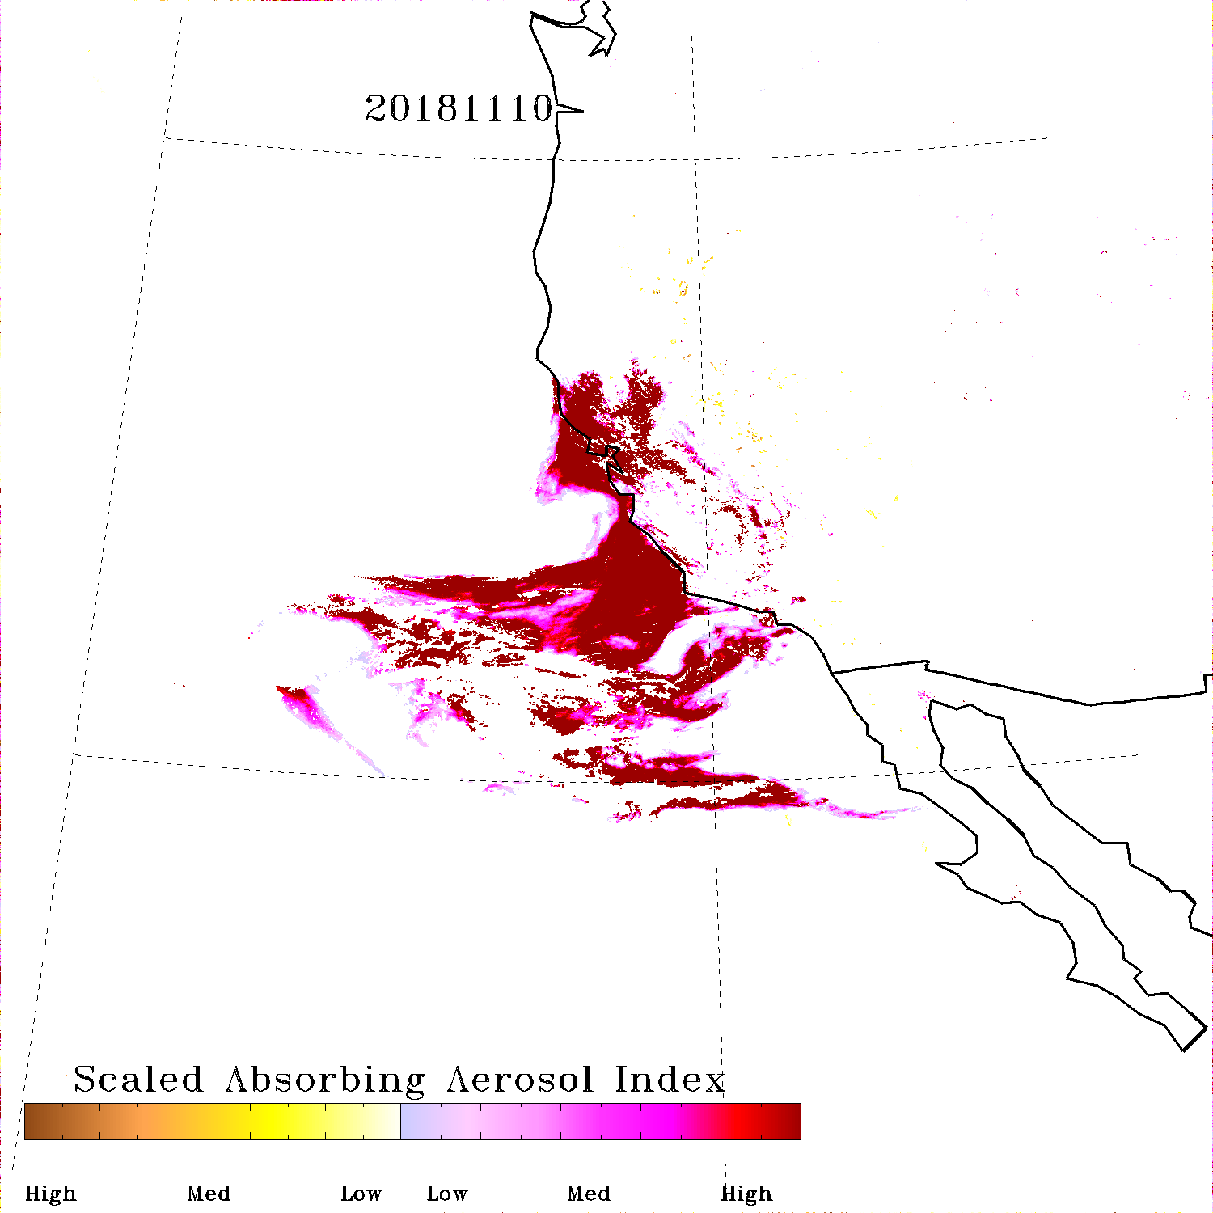
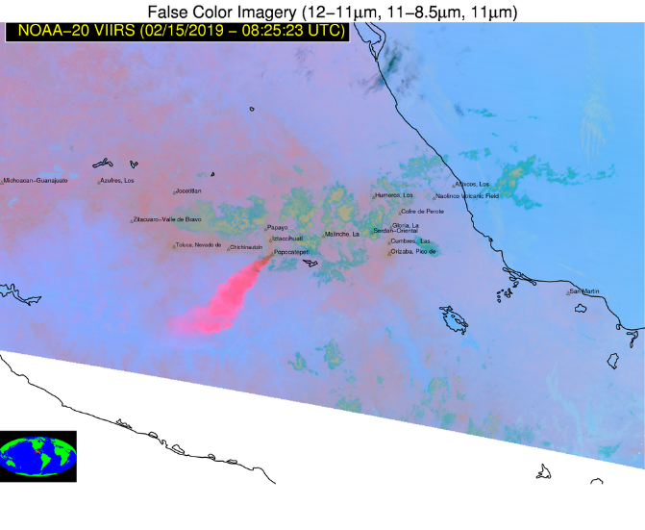
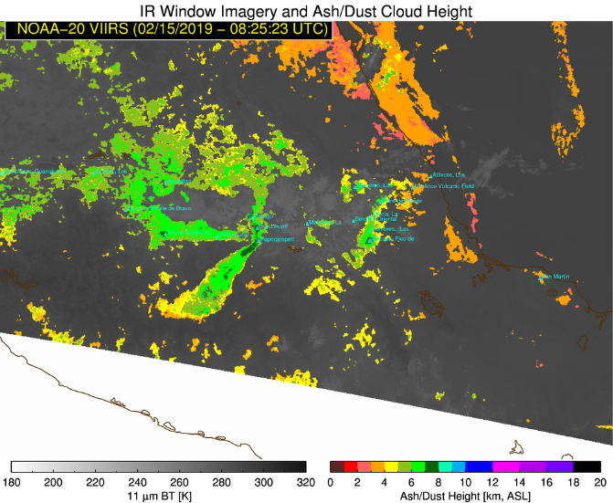
JPSS Data Products available via CSPP VIIRS Aerosol and Volcanic Ash Products
Aerosol Detection | A summary map that indicates the extent of smoke/aerosol coverage and a measure of smoke albedo indicates relative intensity.
Aerosol Optical Depth | A measure of the fine solids suspended in the air including dust, sand, volcanic ash, smoke and urban/industrial aerosols.
Aerosol Particle Size | A measure of the bimodal size distribution of the aerosol population in terms of the effective radius (re) and effective variance (ve) of each mode.
Volcanic Ash – Detection and Height | Maps the location and concentration of volcanic ash after an eruption and dispersion by the wind.
VIIRS Aerosol Detection
Dust
Smoke
Above: Smoke from California Camp Fire on November 10, 2018
VIIRS Imagery (left) and Aerosol Detection (right)
Left: False Color Imagery + Volcanic Ash/Dust Cloud Height
(Feb 15, 2019)
Aerosol Image courtesy of Dr. Shobha Kondragunta, NOAA/NESDIS/STAR
Volcanic Ash Imager Courtesy of Dr. Michael Pavolonis, NOAA/NESDIS/STAR

Slide 9
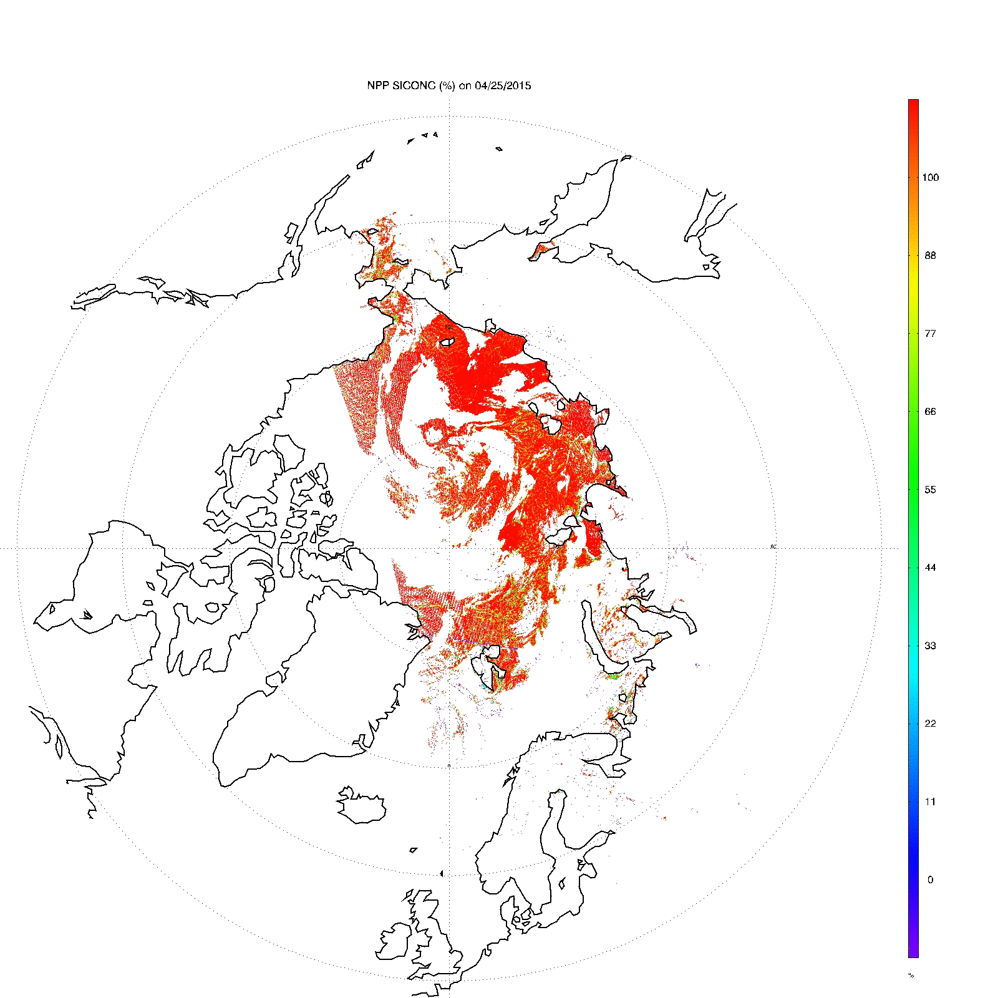
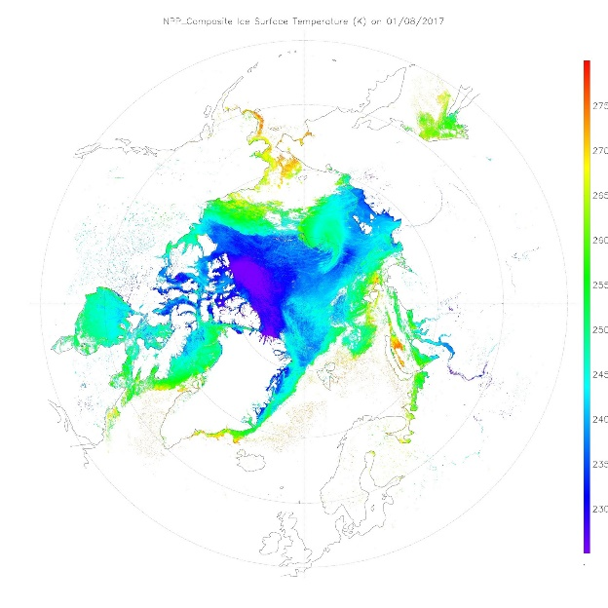
JPSS Data Products available via CSPP VIIRS Cryosphere Products
VIIRS Ice Concentration
Ice Surface Temperature | IST provides the radiating, or “skin”, temperature of the sea and fresh water ice surface under clear-sky conditions. It includes the aggregate temperature of objects comprising the ice surface, including snow and melt water on the ice. The VIIRS IST EDR provides surface temperatures retrieved at VIIRS moderate resolution for ice-covered oceans both day and night.
Ice Concentration | Ice concentration provides the fraction of an area covered by ice. It is calculated for every VIIRS moderate resolution band pixel (750 m) over unfrozen ocean and inland water bodies.
Ice Thickness | VIIRS ice thickness provides estimates of sea, lake, and river ice thickness under clear-sky conditions. The ice surface may be covered by snow or, in the summer, melt ponds. The depth of snow is not included in ice thickness product. Calculations are done at VIIRS moderate resolution (750 m) for ice-covered water bodies both day and night. It is not a direct measurement, but rather a model-based approach driven by other satellite products.
Snow Cover | The snow cover product contains two products: a fractional snow cover (FSC) and a binary snow cover (BSC) mask. The fractional snow cover is defined as the fraction of a given area of the earth’s horizontal surface that is masked by snow. The binary snow/no-snow mask provides a mapping of snow covered areas as either containing or not having snow.
VIIRS Ice Surface Temperature

Slide 10
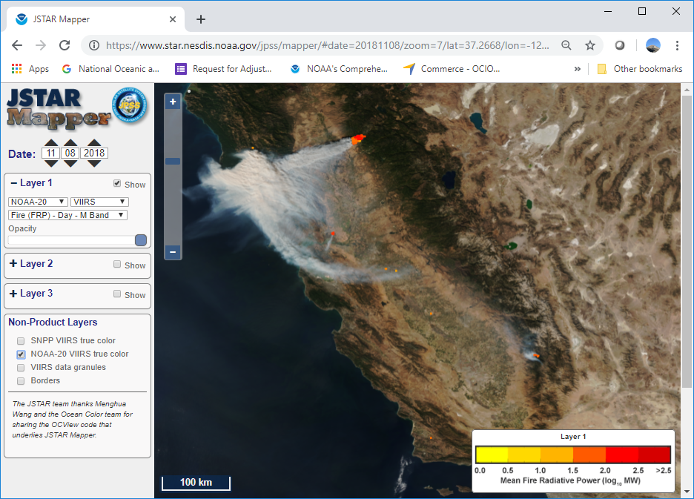
JPSS Data Products available via CSPP VIIRS Land Products
Land Surface Temperature | Measurement of the skin temperature over global land coverage including coastal and inland water.
Land Surface Albedo | The Ratio between solar radiation reflected by Earth’s land surface and solar radiation incident at the surface.
Active Fires | A 2-Dimentional array of values representing the fire and other relevant thematic classes of each pixel.
Flood Detection | High resolution remotely-sensed data identifying flood inundation and extent generated from the 375 m VIIRS Initially designed to capture snowmelt and ice jam flooding and inundation but has expanded applications to levee breaches, post-storm flooding, and more
N20 Active Fires – Fire Radiative Power
Image courtesy of Dr. Ivan Csiszar, NOAA/NESDIS/STAR

Slide 11
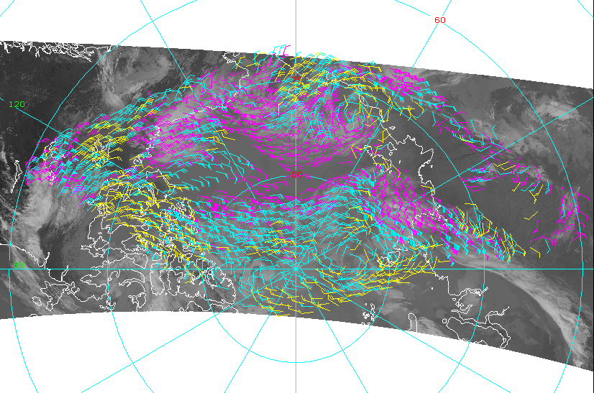
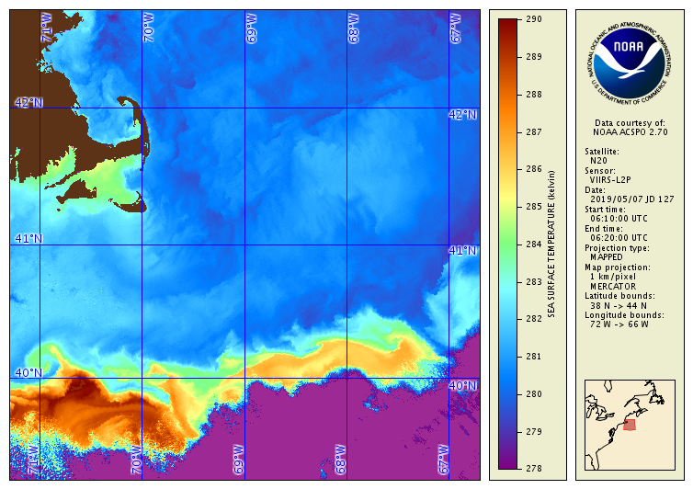
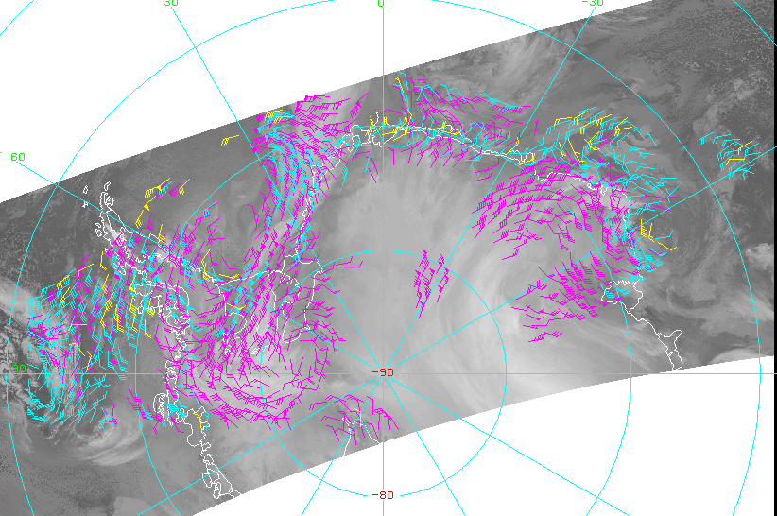
JPSS Data Products available via CSPP VIIRS Sea Surface Temperature and Polar Winds Products
Sea Surface Temperature | Skin temperature of the ocean at depths on the order of 10 microns is retrieved in each cloud-free pixel over water.
Polar Winds | Winds derived by tracking clouds features in the VIIRS longwave infrared channel. Wind speed, direction, and height are measured throughout the troposphere, pole-ward of approximately 65 degrees latitude, in cloudy areas only.
VIIRS Polar Winds
Arctic, 28 July 2018, 1942Z
VIIRS Polar Winds
Antarctic, 28 July 2018, 2033Z
N20 Sea Surface Temperature, May 7, 2019

Slide 12
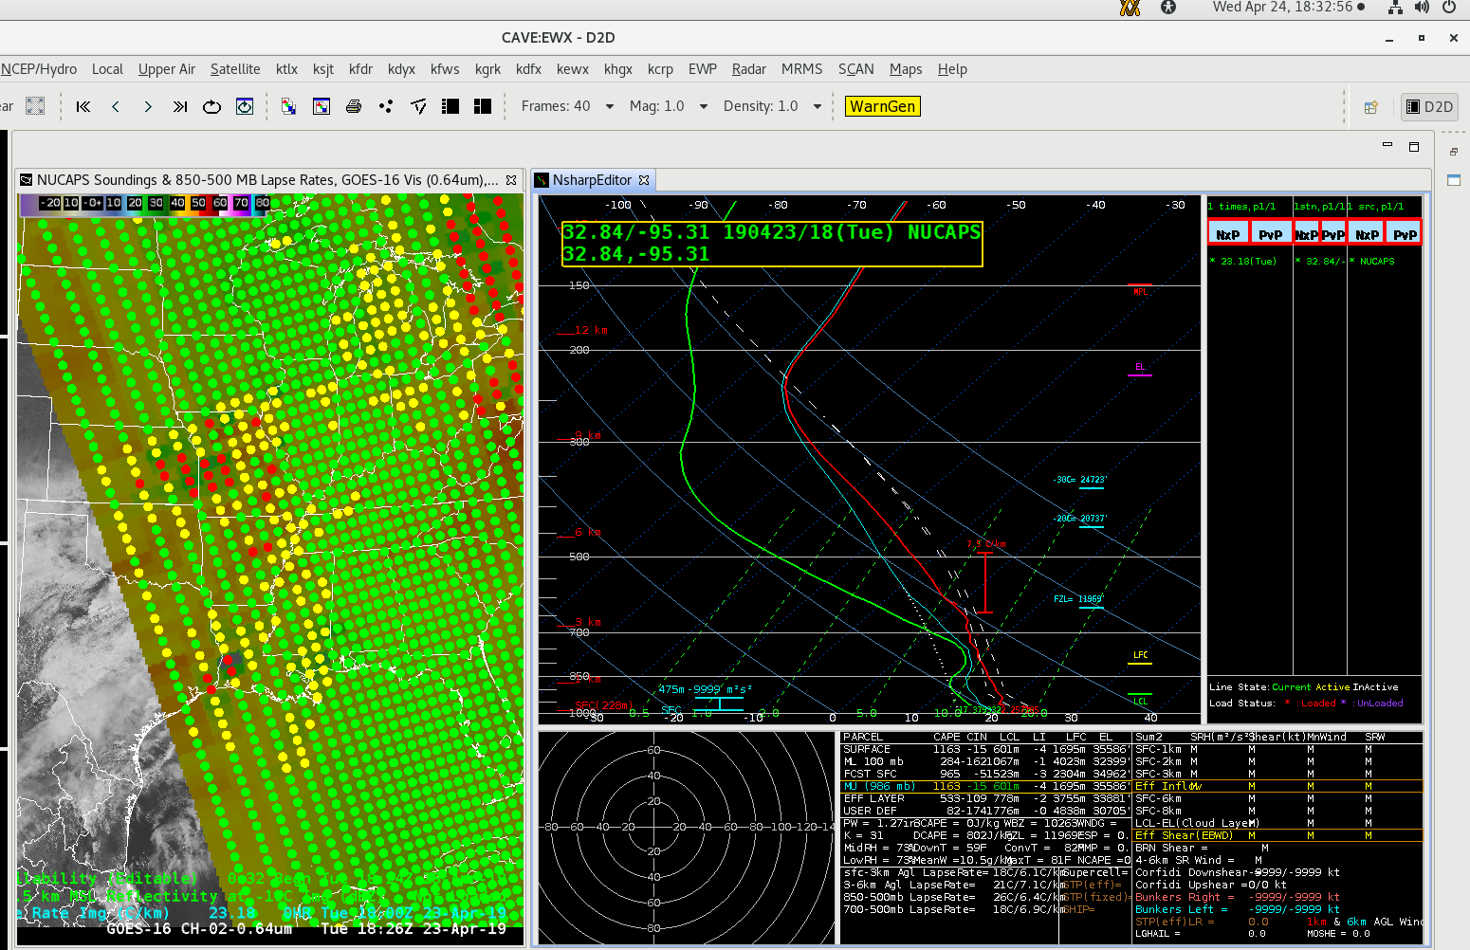
JPSS Data Products available via CSPP CrIS and ATMS: NOAA Unique Combined Atmospheric Product Suite (NUCAPS)
Atmospheric Vertical Moisture Profile | Vertical sampling of atmospheric moisture (water vapor) between 1100 hPa and 0.016 hPA – a total of 100 layers.
Atmospheric Vertical Temperature Profile | Vertical sampling of atmospheric temperature between 1100 hPa and 0.016 hPA – a total of 100 points.
Carbon Dioxide | Retrievals of column and total carbon dioxide, calibrated by the users with ground-based measurements, of stated precision needed to afford deduction of long-term variations and trends.
Carbon Monoxide | Measure of the carbon monoxide in a specified volume of air.
Methane | Measure of the amount of methane in a specified volume of air.
Infrared Ozone Profile | Measurement or first guess of the ozone in 100 layers.
Outgoing Longwave Radiation | Instantaneous radiative energy emitted by the Earth-atmosphere system at the Top of the Atmosphere (TOA) to space into a hemisphere.
NUCAPS Sounding, April 23, 2019

Slide 13
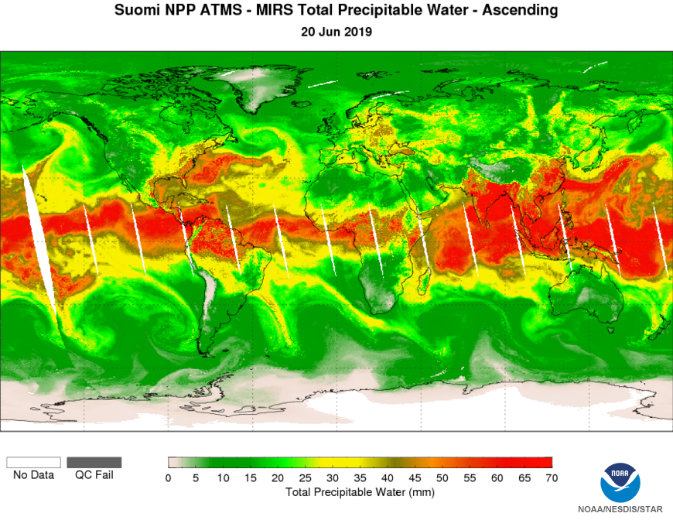
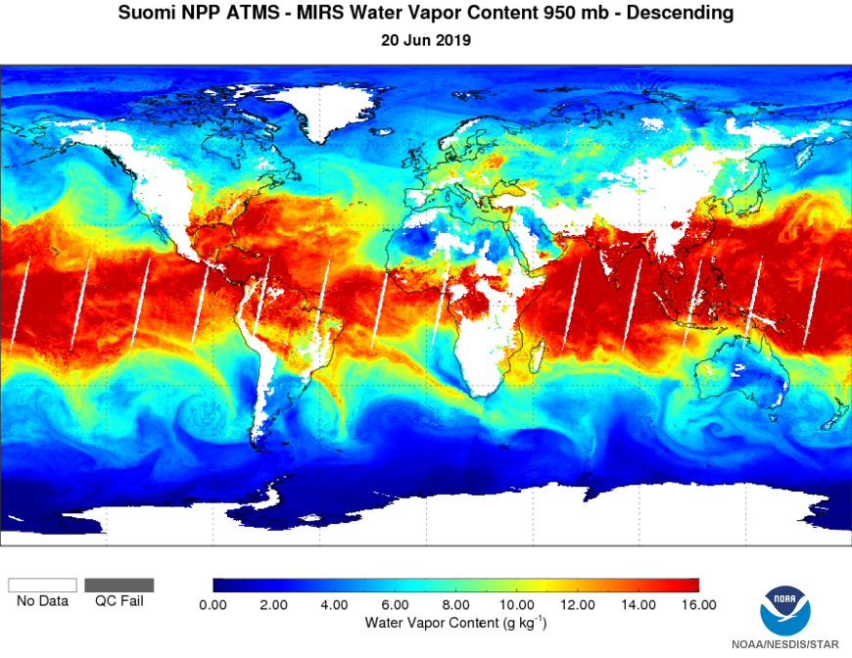
JPSS Data Products available via CSPP ATMS - Microwave Integrated Retrieval Suite (MIRS) Products
Cloud Liquid Water | The equivalent amount of water within a cloud in a specified segment of a vertical column of the atmosphere.
Ice Concentration | The areal extent of sea ice relative to the total at a given location in the ocean. It is empirically derived using the natural variation in the emissivity of ice and water in the microwave frequencies between 23 and 50 GHz.
Imagery | ATMS image is a limb-corrected nadir view of the ATMS Temperature Data Record.
Land Surface Emissivity | Relative ability of the land surface to emit energy by radiation.
Land Surface Temperature | The sensor-facing skin temperature of the land surface. It includes the aggregate temperature of objects comprising the land surface, including any open water, in the cell.
Moisture Profile | A calculation of the mixing ratio at specified points along a local vertical. The mixing ratio of a sample of air is the ratio of the mass of water vapor in the sample to the mass of dry air in the sample.
Rainfall Rate | The amount of rainfall during a period of time. The required Rainfall Rate products provide the instantaneous rainfall rate during the time of observation in mm/hour.
Snow Cover
Snowfall Rate | Water equivalent snowfall rate estimate.
Snow Water Equivalent | The product of snow depth and snow relative density (with respect to the density of liquid water), a measure of the amount of water stored in a snowpack per unit area; it is expressed in units of length (e.g., cm or inches), being a quantity of type surface density, normalized by water density. It is the depth of water in the snowpack, if the snowpack were melted.
Temperature Profile | A calculation of temperatures at stated intervals throughout the atmosphere.
Total Precipitable Water | The total column amount of water vapor available in a vertical atmospheric profile.

Slide 14
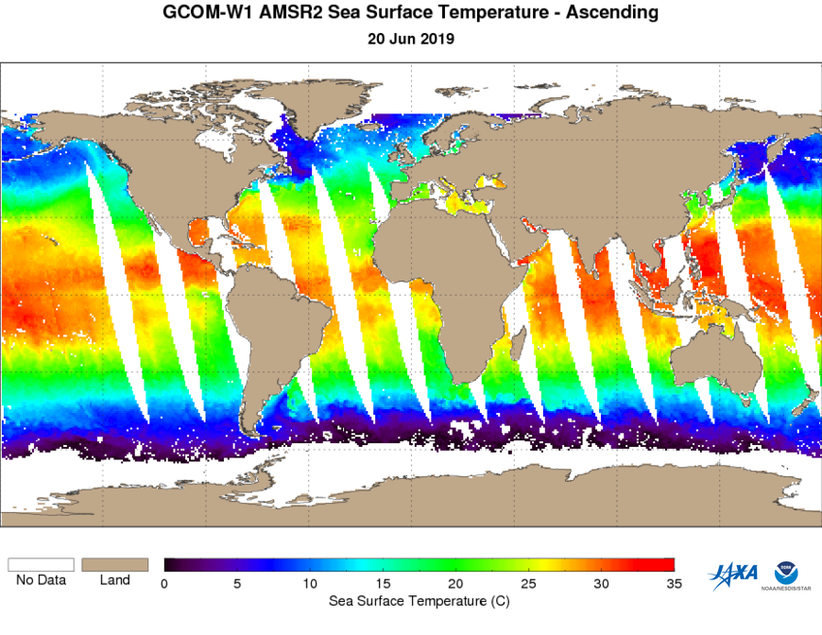
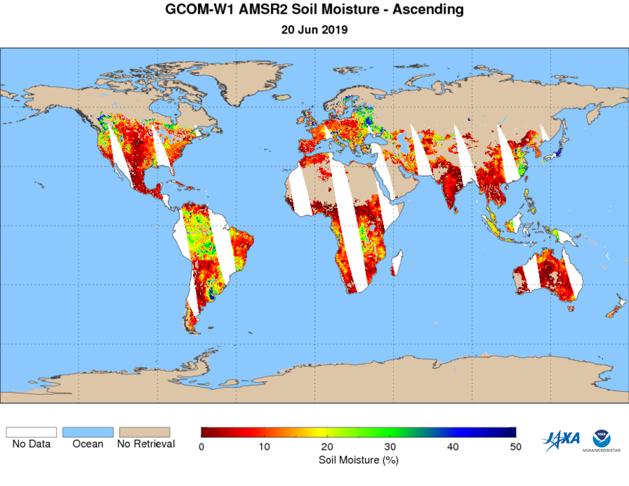
JPSS Data Products *soon to be* available via CSPP GCOM-W1 AMSR-2 Products
Cloud Liquid Water | Equivalent amount of water within a cloud in a specified segment of a vertical column of the atmosphere.
Imagery | Brightness temperature data from each microwave channel display at the native resolution.
Rainfall type/rate | Amount of rainfall during a period of time.
Sea Ice Characterization | Sea Ice properties derived from all-weather imagery.
Sea surface Temperature | Skin temperature of the ocean at depths on the order of 10 microns is retrieved in each cloud-free pixel over water.
Sea Surface Wind Speed | Measure of atmospheric wind speed/direction at the sea/atmosphere interface in clear sky and cloudy conditions.
Snow Cover | Horizontal extent of snow cover.
Snow Water Equivalent | Snow-Water Equivalent (SWE) is the product of snow depth and snow relative density (with respect to the density of liquid water), a measure of the amount of water stored in a snowpack per unit area; it is expressed in units of length (e.g., cm or inches), being a quantity of type surface density, normalized by water density. It is the depth of water in the snowpack, if the snowpack were melted.
Soil Moisture | Moisture within the surface soil layer to the depth where microwave emission or reflection signals can be sensed by satellite sensors.
Total Precipitable Water | Total equivalent water of unit cross-sectional area between any two specified levels, including the total atmospheric column.

Slide 15
Summary
JPSS provides global coverage of atmospheric, land, and oceanic data from visible, infrared, and microwave instrumentation on S-NPP and NOAA-20.
These level-2 geophysical data are processed through the NOAA ground system as well as CSPP.
JPSS is working with University of Wisconsin, CIMSS to ensure the data produced using CSPP are the same quality as those produced through the NOAA ground system.

Slide 16
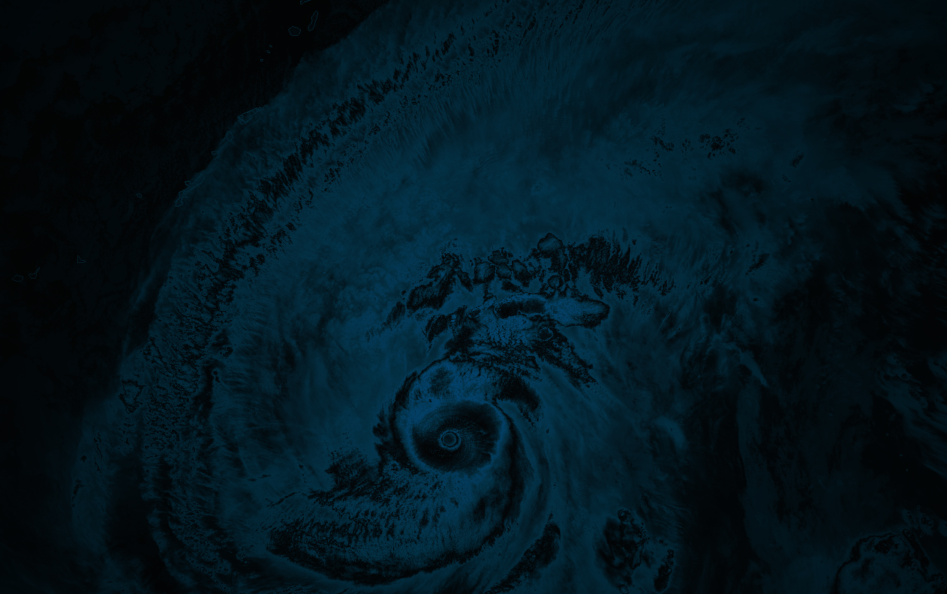
THANK YOU!
For more information visit: www.jpss.noaa.gov
CONNECT WITH US!
v
/NOAASATELLITES
@NOAASATELLITES
@NOAASATELLITES
/NOAASATELLITES

Slide 17
S-NPP Operational Data Products
ATMS |  | CrIS | OMPS | VIIRS |  |  | AMSR-2
Cloud Liquid Water | Rainfall Rate | Carbon Dioxide | Limb SDR | Active Fires | Cloud Particle Size Distribution | Land Surface Temperature | Calibrated Sensor Data
Ice Concentration | Snow Cover | Carbon Monoxide | Nadir Profile | Aerosol Detection | Cloud Phase | Ocean Color | Cloud Liquid Water
Imagery | Snowfall Rate | Methane | Total Column | Aerosol Optical Depth | Cloud Top Pressure | Polar Winds | Imagery
Land Surface Emissivity | Snow Water Equivalent | Infrared Ozone Profile | Limb Profile | Aerosol Particle Size | Cloud Top Temperature | Sea Surface Temperature | Rainfall (type/Rate)
Land Surface Temperature | Temperature Profile | Outgoing Longwave Radiation |  | Albedo (surface) | Green Vegetation Fraction | Snow Cover | Sea Ice Characterization
Moisture Profile | Total Precipitable Water |  |  | Annual Surface Type | Ice Age/Thickness | Surface Reflectance | Sea Surface Temperature
Atmospheric Vertical Temperature Profiles |  |  |  | Cloud Height (Top & Base) | Ice Concentration | Vegetation Health Index Suite | Sea Surface Wind Speed
Atmospheric Vertical Moisture Profiles |  |  |  | Cloud cover/layers | Ice Surface Temperature | Vegetation Indices | Snow Cover
 |  |  |  | Cloud Mask | Imagery | Volcanic Ash Detection & Height | Snow Water Equivalent
 |  |  |  | Cloud Optical Depth |  |  | Soil Moisture
 |  |  |  |  |  |  | Total Precipitable Water
Color Key
Green Shading = Operational

Slide 18
N20 Operational Data Products
ATMS |  | CrIS | OMPS | VIIRS |  |  | AMSR-2
Cloud Liquid Water | Rainfall Rate | Carbon Dioxide | Limb SDR | Active Fires | Cloud Particle Size Distribution | Land Surface Temperature | Calibrated Sensor Data
Ice Concentration | Snow Cover | Carbon Monoxide | Nadir Profile | Aerosol Detection | Cloud Phase | Ocean Color | Cloud Liquid Water
Imagery | Snowfall Rate | Methane | Total Column | Aerosol Optical Depth | Cloud Top Pressure | Polar Winds | Imagery
Land Surface Emissivity | Snow Water Equivalent | Infrared Ozone Profile | Limb Profile | Aerosol Particle Size | Cloud Top Temperature | Sea Surface Temperature | Rainfall (type/Rate)
Land Surface Temperature | Temperature Profile | Outgoing Longwave Radiation |  | Albedo (surface) | Green Vegetation Fraction | Snow Cover | Sea Ice Characterization
Moisture Profile | Total Precipitable Water |  |  | Annual Surface Type | Ice Age/Thickness | Surface Reflectance | Sea Surface Temperature
Atmospheric Vertical Temperature Profiles |  |  |  | Cloud Height (Top & Base) | Ice Concentration | Vegetation Health Index Suite | Sea Surface Wind Speed
Atmospheric Vertical Moisture Profiles |  |  |  | Cloud cover/layers | Ice Surface Temperature | Vegetation Indices | Snow Cover
 |  |  |  | Cloud Mask | Imagery | Volcanic Ash Detection & Height | Snow Water Equivalent
 |  |  |  | Cloud Optical Depth |  |  | Soil Moisture
 |  |  |  |  |  |  | Total Precipitable Water
Color Key
Green Shading = Operational
White Shading = Not Operational
Gray Shading = Not Applicable to N20

